Slide 1
Citation Provenance
FYP Presentation
Heng Low Wee
19 Nov 2012

Slide 2
Citations in research papers give credit and uphold intellectual property

Slide 3
Citations refer to cited document for information. Problem?
Most citations are mere mentions
Even if referring to claims specifically, it is not immediately clear where is this information in the cited document

Slide 4
Difficult to find the exact text in the cited paper to justify the citation
Citation usually don’t include position of the information in the cited article…

Slide 5
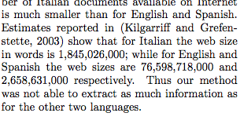

Slide 6
What is Citation Provenance?

Slide 7
Task: To locate the information in the cited paper that justifies the citation

Slide 8
Aim: To identify which section or paragraph in the cited paper is the cited information

Slide 9
Outline
Introduction
Related Work
Problem Analysis
Approach
Evaluation
Discussion & Conclusion

Slide 10
Related Work

Slide 11
Citation Classification
To classify citations into pre-defined classes so as to determine the rationale for citing
12-class annotation scheme [Teufel et al, 2009]
Citances (Citing context) [Nakov et al, 2004]
Automatic citation classification
Features from citances
Cue words/phrases

Slide 12
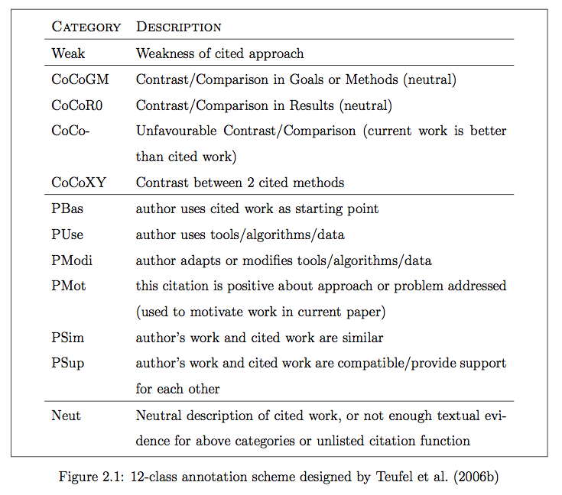

Slide 13
Content-Sensitive In-Browser Summariser (CSIBS)
Conducted series of survey
Difficult to find exact text that justifies citation
Citation does not include position of origin
Literature browsing; Summarisation tool
Displays preview of cited document; Highlight content-sensitive keywords
Wan et al, 2010

Slide 14
Sentence Alignment / Paraphrase
Nelken & Sheiber, 2006 presented a novel algorithm that produced great precision at aligning sentences in monolingual corpora
Shinyama et al, 2002 worked on automatic paraphrase extraction from news article

Slide 15
Related Work - Summary
Citation-related tasks require extracting features from citing context
There is demand for a reading tool that answers readers’ doubt – where is the origin of the citation?
A need to handle paraphrasing that is common when making citations

Slide 16
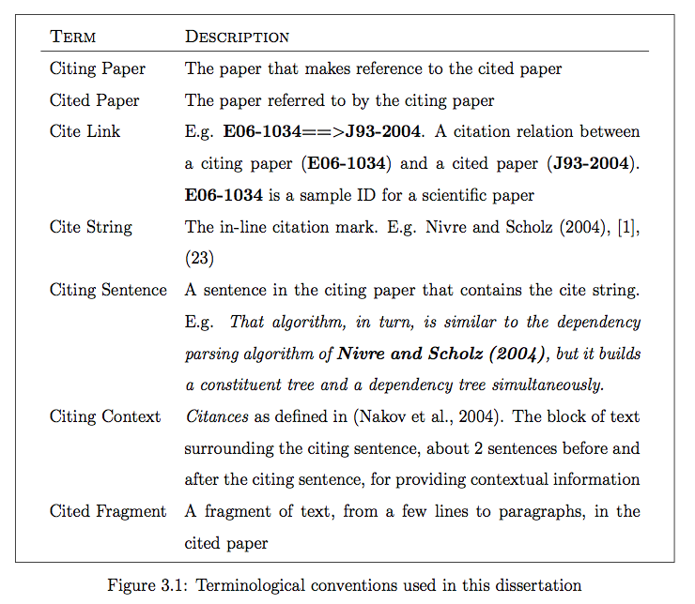
Terminology

Slide 17
Problem Analysis

Slide 18
Problems (Recap)
Most citation are only mentions
Even if specifically referring to claims, not immediately clear where this info is in the cited document
Difficult to find the info that justifies the citation
Citation usually don’t include position of info in the cited article

Slide 19
Is the citation a mere mention?
What is a mention? What is not?
How to tell whether it is just a mention or not?
If it is referring to specific information, how do we locate it in the cited paper?

Slide 20
General vs Specific

Slide 21
General Citations
Authors may refer to paper…
as a whole. If author cites for a key idea, e.g. Machine Learning, and this idea makes up the entire paper
just to mention it. Give credit; acknowledgement

Slide 22
Specific Citations
Authors may refer to paper…
For Term definitions
Key idea/implementation. It does not make up the entire paper
Algorithm/Theorem. It does not make up the entire paper
Digits/numerical figures. E.g. refer to evaluation results. To complement performance
Notes:
This observations apply for the corpus we are working with

Slide 23
Scope of the Problem
Splitting the problem into 2 tiers
First tier: Determine whether General or Specific. If general, citation provenance is set to be Abstract section.
Second tier: If Specific, there must exists a region in the cited paper that the citation is referring to.
To implement a ranking system to locate this region
Focus on citation provenance, abstract away the problem of locating in-line citations.
Use ParsCit [Councill et al, 2008] to extract citances and citing context

Slide 24
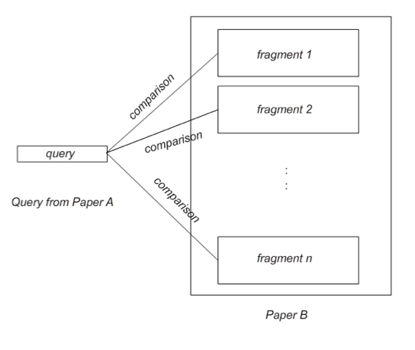
Modeling Our Problem

Slide 25
Target Corpus
ACL-Anthology Reference Corpus (ACL-ARC)
Computational Linguistic papers
Interlink data
E.g. X98-1031==>X96-1049
Citation relationships
Just a start; Aim to eventually generalize to all fields of research

Slide 26
What data do we need?
Which paper cites which paper? Paper A cites Paper B?
Cite link. E.g. X98-1031==>X96-1049
Contextual information? We need more information than just the cite string (E.g. [1], Nelken & Sheiber, 2006)
Citances / Citing context
Paper A might cite Paper B multiple times, hence multiple citing contexts
Where is the cited information?
Fragments (arbitrary length) in cited document
We also need to know which fragments these contexts ‘map’ to
Which fragment is the origin / cited information

Slide 27
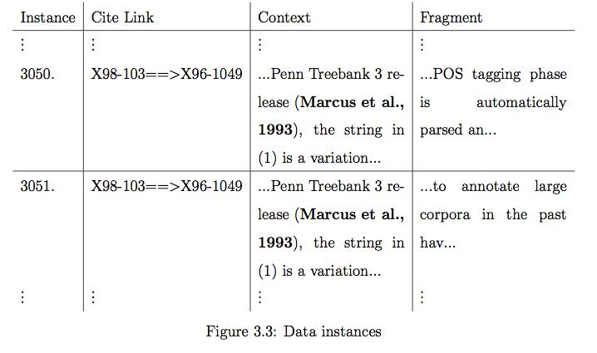
What data do we need?

Slide 28
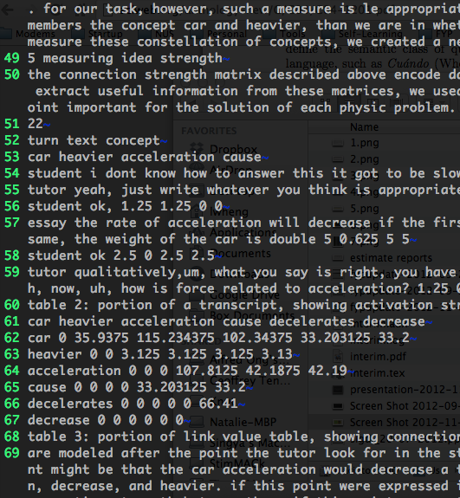
Collecting Annotation – 1st Attempt
Citing Context
Citing
Cited

Slide 29
Collecting Annotation – 1st Attempt
Supplied plain text files of citing & cited papers
Annotate by line number range. E.g. L12-55
Build a web interface annotation framework to help annotators select these lines
2 means:
Collect from NUS students (close supervision)
Amazon Mechanical Turk (crowdsourcing; large scale)
NUS Institutional Review Board (IRB)
Applied and approved

Slide 30
Collecting Annotation – 1st Attempt
After a trial round of annotation:
Annotation task is non-trivial
Need to understand content; research experience; experience in reading research papers
Annotation scheme is too tricky
Annotating by line number is bad idea. Difficult to judge correctness
Annotation: L12-55
Prediction: L50-78
Overlap? Yes. Correct? ????
Annotations disagree among annotators

Slide 31
Collecting Annotation – 2nd Attempt
:
Fragment 1
Fragment 2
Citing Context
Fragment 3
Fragment i
:
Fragment m
Citing
Cited

Slide 32
Collecting Annotation – 2nd Attempt
Annotate by fragments. Use ParsCit [Councill et al, 2008] for fragment cited paper
For each citation, for each context, for each fragment, annotate with labels:
General (g)
Specific-Yes (y)
Specific-No (n)
Manually annotated

Slide 33
Example
Citing Context
Fragment
ario considers as attribute information prefixes of words in combination with attributes whose values are obtained from the Internet. These Internet based attributes are targeted to extract evidence of the possible semantic class of the question. The next subsection will explain how the Internet is used to extract attributes for our question classification problem. In subsection 3.2 we present a brief description of Support Vector Machines, the learning algorithm used on our experiments. 3.1 Using Internet As Kilgarriff and Grefenstette wrote, the Internet is a fabulous linguists’ playground (Kilgarriff and Grefenstette, 2003). It has become the greatest information source available worldwide, and although English is the dominant language represented on the Internet it is very likely that one can find information in almost any desired language. Considering this, and the fact that the texts are written in natural language, we believe that new methods that take advantage of this large corpus must be devised. In this work we propose using the Internet in order to acquire information that can be used as attributes in our classification problem. This attribute information can be extracted automatically from the web and
The Web, teeming as it is with language data, of all manner of varieties and languages, in vast quantity and freely available, is a fabulous linguists’ playground. This special issue of Computational Linguistics explores ways in which this dream is being explored.

Slide 34
Example
Citing Context
Fragment
nformation, as oppose to using prefixes of size 4. For Italian language the best results were obtained from using prefixes of size 4. And for the three languages the Internet-based attributes had rather low accuracies, the lowest being for Italian. When we analyzed the results computed for Italian, using our Internet-based attributes, we realized that in many cases we could not get any results to the queries. One plausible explanation for this lack of information, is that the number of Italian documents available on Internet is much smaller than for English and Spanish. Estimates reported in (Kilgarriff and Grefenstette, 2003) show that for Italian the web size in words is 1,845,026,000; while for English and Spanish the web sizes are 76,598,718,000 and 2,658,631,000 respectively. Thus our method was not able to extract as much information as for the other two languages. 4.3 Combining Internet-based Attributes with Lexical Features Results presented in the previous subsection show how by using just lexical information we can train SVM and achieve high accuracies in the three languages. But our goal is to discover the usefulness of using Internet in order to extract attributes for question classification. We perform
Estimates of Web size in words, as indexed by AltaVista, for various languages. Language Web Size Language Web Size Albanian 10,332,000 Catalan 203,592,000 Breton 12,705,000 Slovakian 216,595,000 Welsh 14,993,000 Polish 322,283,000 Lithuanian 35,426,000 Finnish 326,379,000 Latvian 39,679,000 Danish 346,945,000 Icelandic 53,941,000 Hungarian 457,522,000 Basque 55,340,000 Czech 520,181,000 Latin 55,943,000 Norwegian 609,934,000 Esperanto 57,154,000 Swedish 1,003,075,000 Roumanian 86,392,000 Dutch 1,063,012,000 Irish 88,283,000 Portuguese 1,333,664,000 Estonian 98,066,000 Italian 1,845,026,000 Slovenian 119,153,000 Spanish 2,658,631,000 Croatian 136,073,000 French 3,836,874,000 Malay 157,241,000 German 7,035,850,000 Turkish 187,356,000 English 76,598,718,000

Slide 35
Collecting Annotation – 2nd Attempt
Item | Statistics
No. of Cite Links | 275 (7.6% Specific)
No. of Fragments | 30943 (0.09% Specific-Yes, 12.9% Specific-No)

Slide 36
Collecting Annotation – 2nd Attempt
Specific citations can be categorized into 4 sub-classes:
To refer to digits/numerical figures
To refer to term definitions
To refer to algorithm/theorem
To quote
(For this corpus only)

Slide 37
Approach

Slide 38
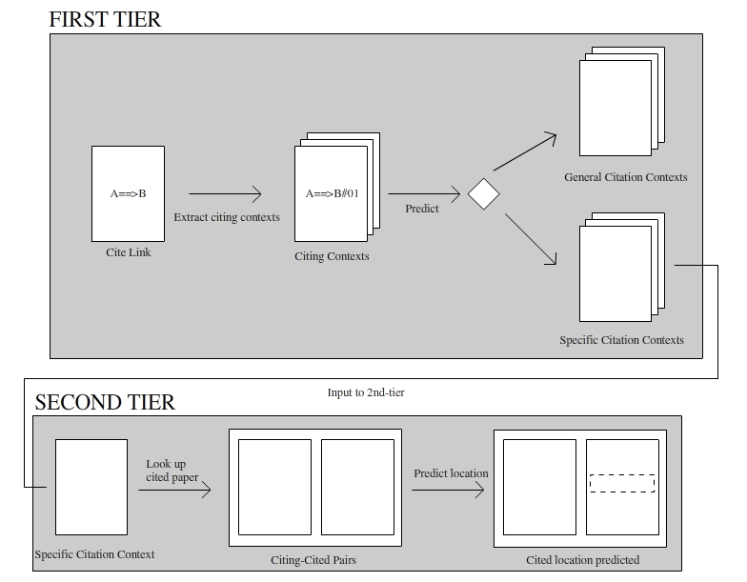
Two-tier Approach

Slide 39
GvS (1st tier)
Item | Statistics
No. of Cite Links | 275 (7.6% Specific)
No. of Fragments | 30943 (0.09% Specific-Yes, 12.9% Specific-No)

Slide 40
GvS (1st tier)
From annotations, this task is heavily skewed towards General citations
Filter out General citations, keep Specific citations
2-class citation classification task
Extract information from citing paper / citances and citing context

Slide 41
GvS Features
Physical Features [Dong & Schaffer, 2011]
Location – section where citing sentence is from
Popularity - # of citation marks in citing sentence
Density - # of unique citation marks in citing sentence and neighbor sentences
AvgDens – average of Density among citing and neighbor sentences
Intuition: From our observations, citations in Evaluation section usually cite results from the same section in the cited paper. Thus location would suggest the type of citation. Also, General citations tend to have high # of citation marks within the sentences

Slide 42
GvS Features
Number Density
Density of numerical figures in citing context
Intuition: Specific citations tend to refer to numerical figures
Published Year Difference
Large publishing time gap; Long term citations are usually for General purposes
Citing Context’s Average TFxIDF weight
Average number of valuable words determined by TFxIDF. Higher values suggest important, signature words pertinent to a specific claim. Thus, suggests a Specific citation

Slide 43
GvS Features
Cue Words [Dong & Schaffer, 2011]
Count of specific cue words that appear in citing and neighbor sentences
Cue-General and CueSpecific

Slide 44
Cue-General
proposed, propose, presented, present, suggested, suggests, described, describe, discuss, discussed, gave, introduction, introduced, shown, showed, sketched, sketch, talked, adopted, adopt, based, originated, originate, built, researchers, comparative, comparison, following, previously, previous
Cue-Specific
obtains, obtained, score, scored, high, F-score, Precision, precision, Recall, recall, estimated, estimates, reported, reports, probability, probabilities, peaked, experimental, experimented, rate, error

Slide 45
Building GvS Model
Recall: Task is heavily skewed towards General citations
A model built on this skewed data would be biased
To address this problem, build model on artificially sample unskewed data.
1:1 General vs Specific instances
Gather all Specific + randomly select same # of General
Appear unrealistic to use this ratio
We are building a model with balanced data to measure its ability to differentiate between the 2 types of citation

Slide 46
Two-tier Approach

Slide 47
LocateProv (2nd tier)
Item | Statistics
No. of Cite Links | 275 (7.6% Specific)
No. of Fragments | 30943 (0.09% Specific-Yes, 12.9% Specific-No)

Slide 48
LocateProv (2nd tier)
Approx 1:1000 (y:g+n)
Extremely skewed against Specific-Yes
Better odds looking alone at Specific citations, ratio about 1:100 (y:n)
Thus, input to LocateProv are Specific citations only
Binary classification on fragments
To predict Specific-Yes or Specific-No

Slide 49
LocateProv Features
Surface Matching
Amount of word overlap between the citing sentence and a fragment in the cited paper
Number Near-Miss
Amount of numerical figures overlap between citing sentence and a fragment in the cited paper
Rounding numbers / Converting to percentage
Based on observations: citations may refer to evaluation refers in cited paper

Slide 50
LocateProv Features
Bigram Matching
Percentage of bigrams overlap between citing sentence and a fragment in the cited paper
Word order
Term definition and quote
Cosine Similarity
Model citing sentence and fragment into vectors
Similarity between the 2 vectors

Slide 51
Building LocateProv Model
Skewed data again
1:1 Specific-Yes vs Specific-No

Slide 52
Evaluation

Slide 53
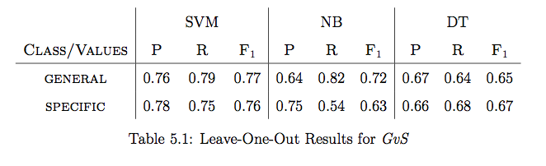
Evaluating GvS
Leave-One-Out strategy
Test on one instance, train model on the rest
Maximize instances for training
Balanced performance

Slide 54
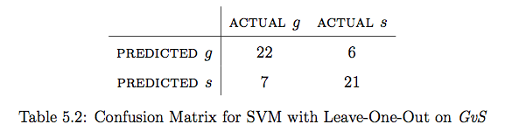
Evaluating GvS

Slide 55
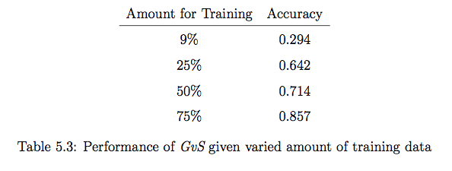
Evaluating GvS
Vary amount of training data
Measure performance with less training data
Increasing performance
Potential to be used in practice if provided large enough dataset

Slide 56
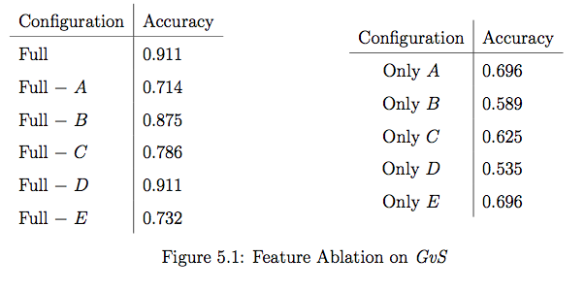
Evaluating GvS
Evaluate discriminative power of features using SVM
A – Physical Feature; B – Number Density; C – Published Year; D – Avg TFxIDF E – Cue Words

Slide 57
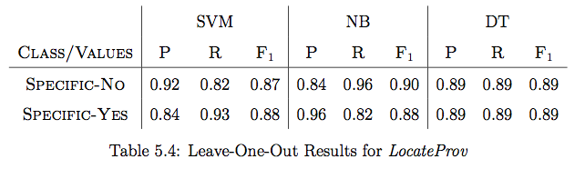
Evaluating LocateProv
Leave-One-Out
Balanced performance

Slide 58
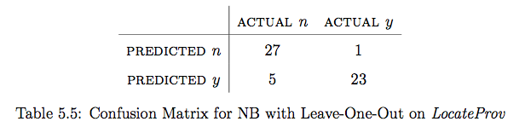
Evaluating LocateProv

Slide 59
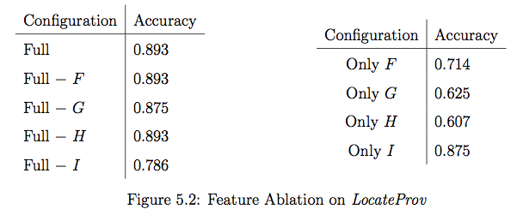
Evaluating LocateProv
Evaluate discriminative power of features added
F – Surface Matching; G – Number Near-Miss; H – Bigram; I – Cosine Sim

Slide 60
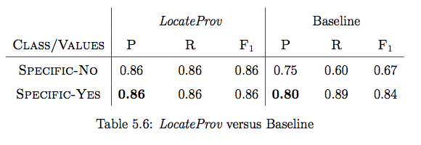
Evaluating LocateProv
Compare with a baseline
Baseline: Only Cosine Sim (Feature I)
Sampled an unskewed dataset
Train on 75%, Test on 25%

Slide 61
Discussion
Challenge: Only 7.6% Specific, only 0.09% Specific-Yes
Focus on LocateProv. Performance slightly better than baseline. As a search it is, there’s room for improvement
Features not yet good enough for this task
Explore more alternatives, e.g., paraphrasing
Citation Provenance
A combination of 2 mechanisms: Citation Classification and Search
Is it worth it to work on Citation Provenance?
Yes. An important reading tool to understand and navigate between papers
Supporting evidence: CitWeb; CodeForScience2012

Slide 62
Conclusion
New task in citation analysis, Citation Provenance
First attempt to provide a solution to the challenge of locating the origin of a citation
2-tier approach
GvS and LocateProv
Filter and Search
Task is heavily skewed
Artificially create unskewed data
Train model on unskewed data
Evaluations showed promising results

Slide 63
Thank You

